Slide 1
Feedforward and Feedback Projections between the V1 and IT Cortex
By Zhuo Wang, Claire Diepenbrock, and Jinqian Li

Slide 2
Introduction
Originally, Chapter Six’s object recognition model only considered with bidirectional connections; there was a hierarchy, and the bidirectional connections ran between these and to the one above and below it. The V1 and IT cortex in the brain however, work much differently. In the actual brain, there very well may be projections from lower levels that project to higher levels. With this in mind, our group added new connections, changed the receptive field perspective, pattern rotation angles, line widths of object images, all in order to see how new objects would be recognized and were altered by our edits. We also created faces and new characters to see new interactions with the simulation.

Slide 3
Different line widths & rotations

Slide 4
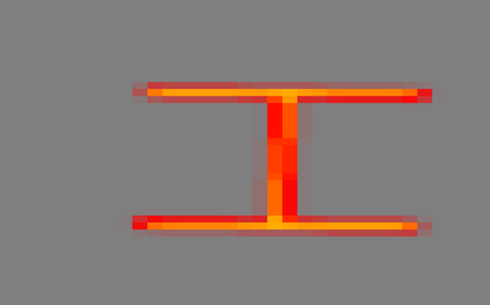
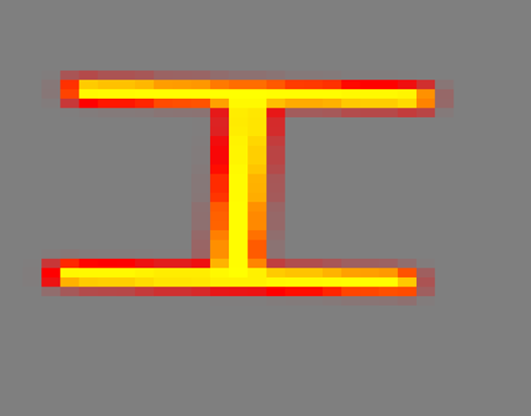
Different line widths
Width = 4
Width = 8
Notes:
So, we wanted to try different parameters in order to see how the outputs would be affected. The two treatments we went for were adjusting the line width and how they were rotated. These are the letters that the simulation was recognizing, and we went in and changed the width. The first is the original with a width of 4, and the second is changed to a width of 8, changing the thickness of the lines. These objects are characterized by horizontal and diagonal lines.

Slide 5
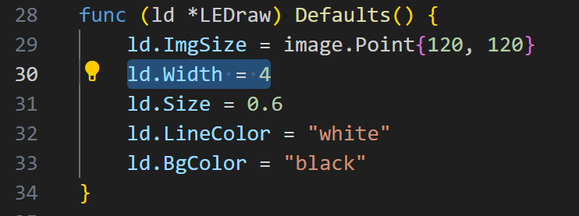
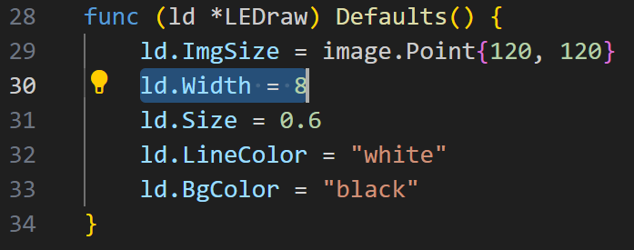
Different line widths
Notes:
This is where the line widths were changed within the leds.go file, just played around to see how dramatic the change was between different numbers.

Slide 6
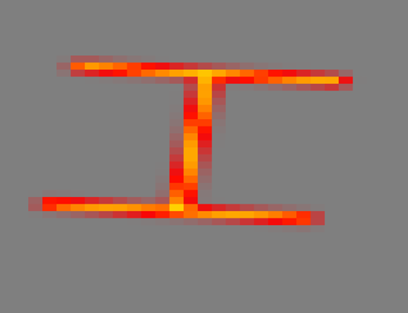
Different line rotations
Original pattern
After rotation
Notes:
We also played with different line rotations, on the left you’ll see the original pattern, and to the right is a slightly altered.

Slide 7
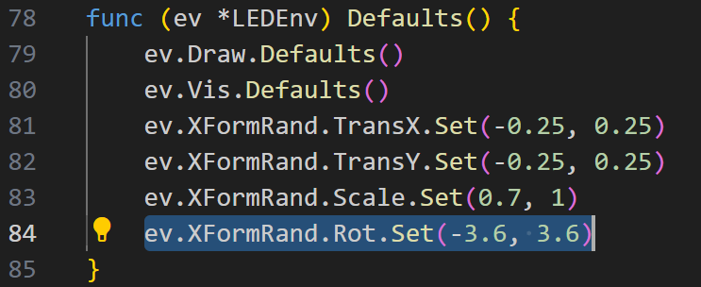
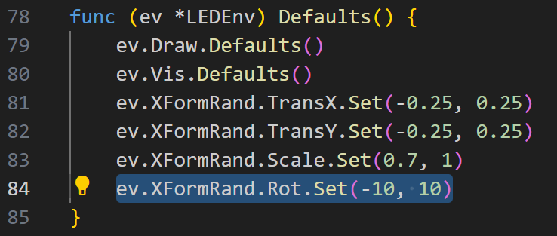
Different line rotations
Notes:
So this is how we did that, by changing the pattern rotation angle. We changed it to -10,10 from -3.6,3.6 and it shows a slight shift in the angle of the object. Here is the transformation in the code.

Slide 8
Different objects
Notes:
When we add a bidirectional connection between the V1 and IT layers of the network, it is natural to think that this may increase the network's ability to recognize objects, so we need more complex objects to train and test the network. In the project, I was mainly responsible for building new objects and using them to test the original and added connected network. The objects used in the homework are objects made up of horizontal and vertical lines of equal length. Therefore, when building new objects, I mainly build objects with different lengths of lines, oblique lines, and points to increase the complexity of the objects. Along these lines, I built three new sets of objects.

Slide 9
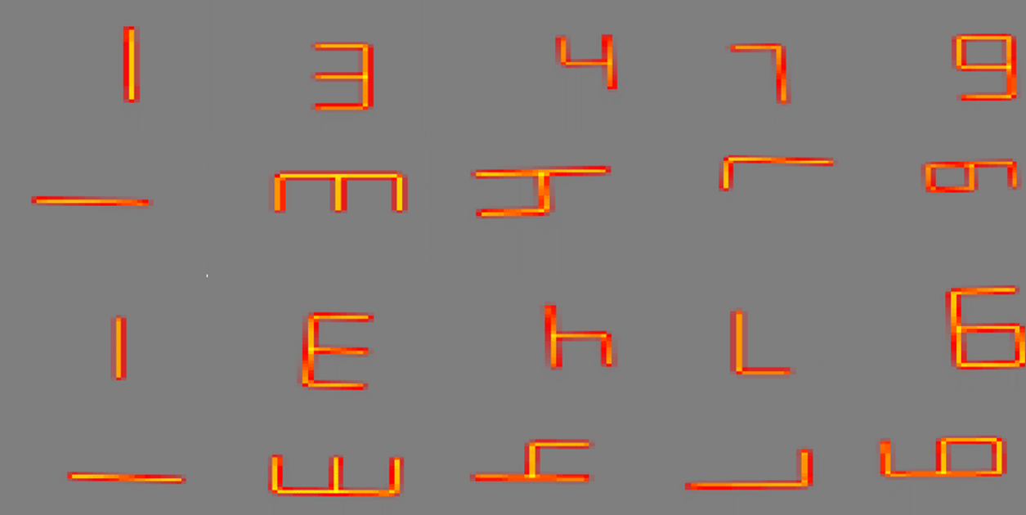
Different objects(Number)
•Vertical and horizontal
•Different length
•4 directions
Notes:
The first set of figures are numbers. This set of figures consists of five numbers: 1,3,4,7,9. Each of these numbers has four different directions. This makes up a total of 20 different shapes. These numbers are characterized by horizontal and vertical lines, but each line is not the same length.

Slide 10
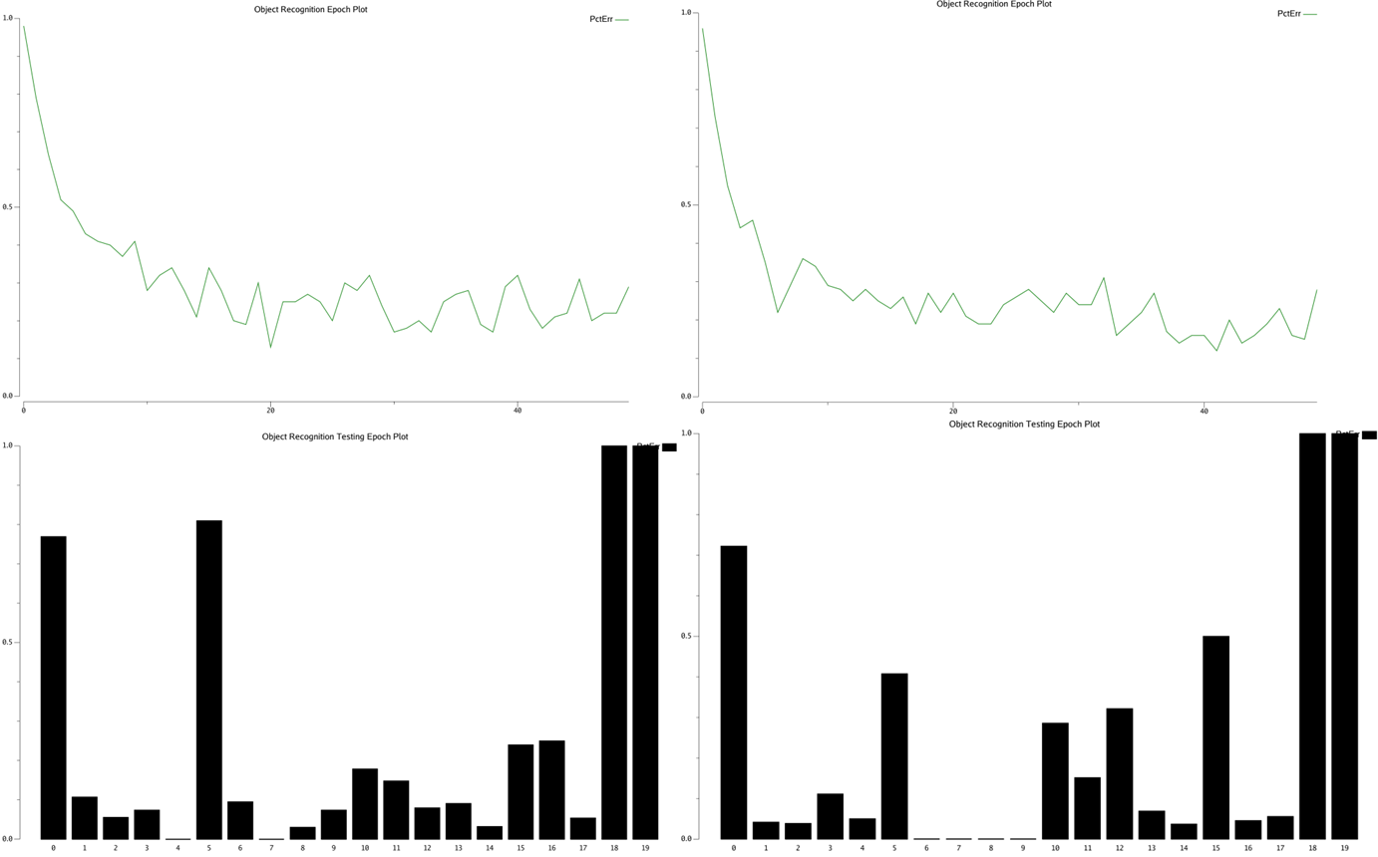
Different objects(Number)
Original Network
Network with V1IT connection
Fewer errors overall
Notes:
Through training and testing, we get the training graphs and test results of different networks for this group of graphs. The left side is the result of the original network, and the right side is the result after adding the V1IT connection. It can be found that the improved network can be trained to achieve lower errors and identify objects more accurately. As can be seen from the figure, objects 18 and 19 have a large error in both networks, which is due to the fact that the network has not trained them to test the generalization ability of the network. However, it can be seen from the results that the network generalization ability has not increased after the improvement.

Slide 11
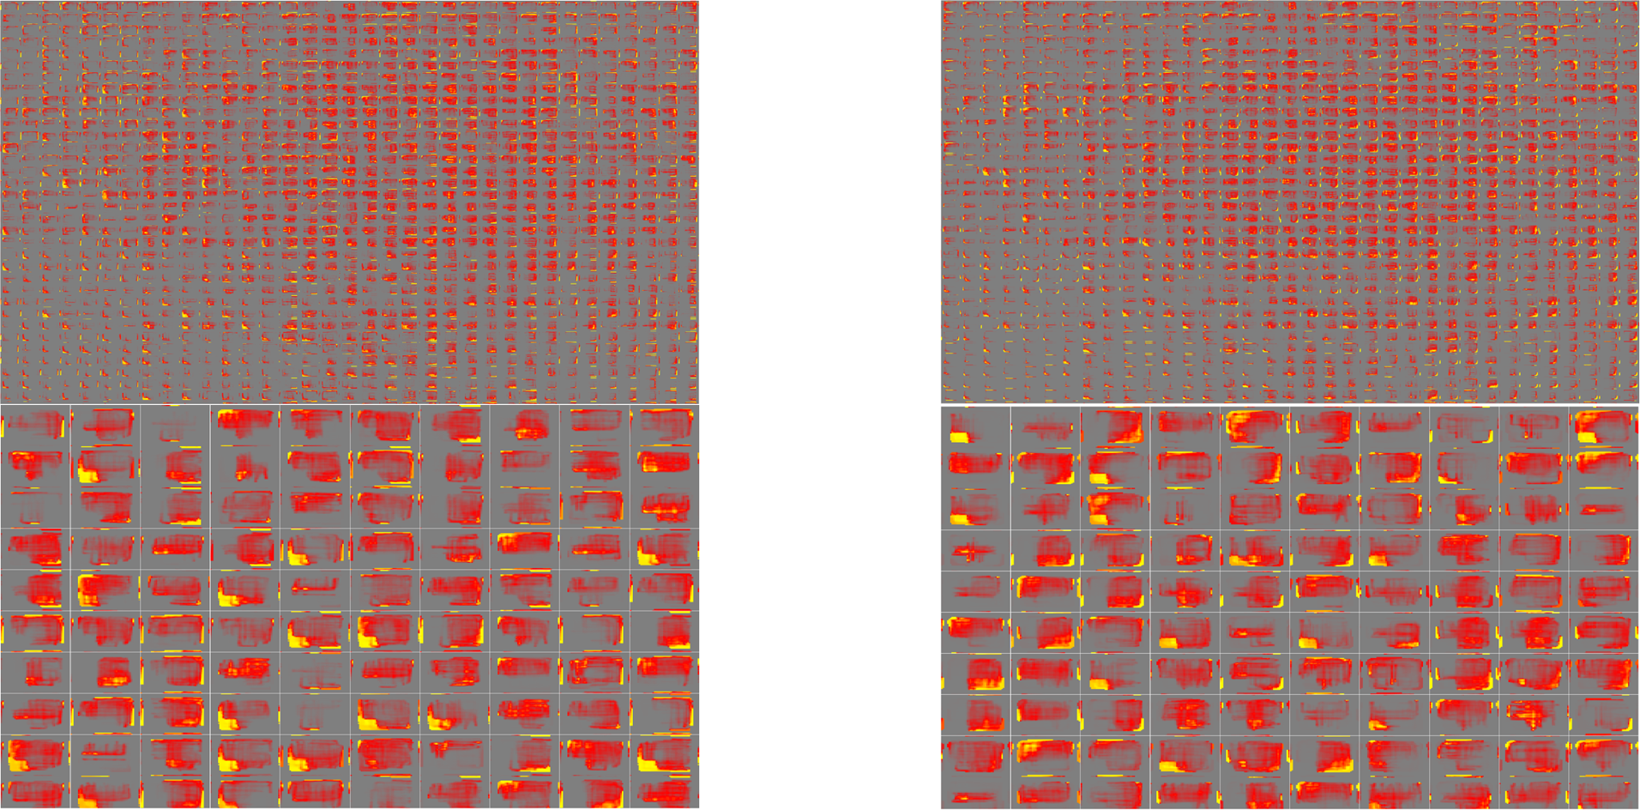
Different objects(Number)
Original Network
Network with V1IT connection
Notes:
In addition to training the effect, we also tested the receptive field of the V4 and IT layers, and as you can see from the figure, the V4 layer seems to be most sensitive to the number 7. The receptive field of the improved network seems to have more units that are more active, possibly because of increased V1 connections to IT, which in turn leads to more activation.

Slide 12
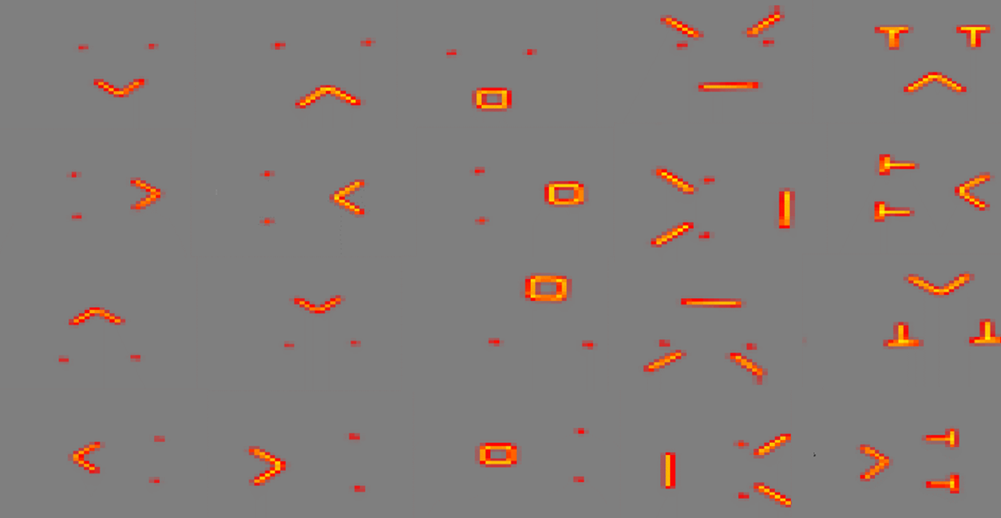
Different objects(Face)
•Vertical,horizontal and oblique
•Different length
•4 directions
Notes:
The second set of shapes is the face. The images were made up of five emojis: happy, unhappy, surprise, angry and sad. Each of these expressions has four different directions. This makes up a total of 20 different shapes. These numbers are characterized by horizontal, vertical and diagonal lines.

Slide 13
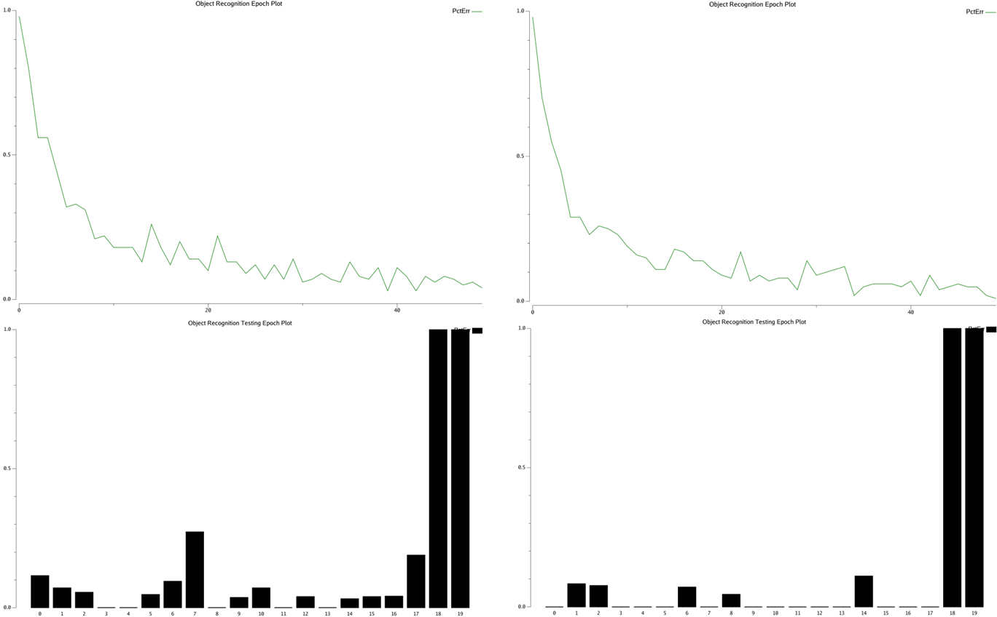
Different objects(Face)
Original Network
Network with V1IT connection
Fewer errors overall
Notes:
Through training and testing, we get the training graphs and test results of different networks for this group of graphs. We can also find that the improved network can be trained to achieve lower errors and identify objects more accurately, but the generalization ability of the improved network does not increase. This set of figures is the best trained of the three sets of figures.

Slide 14
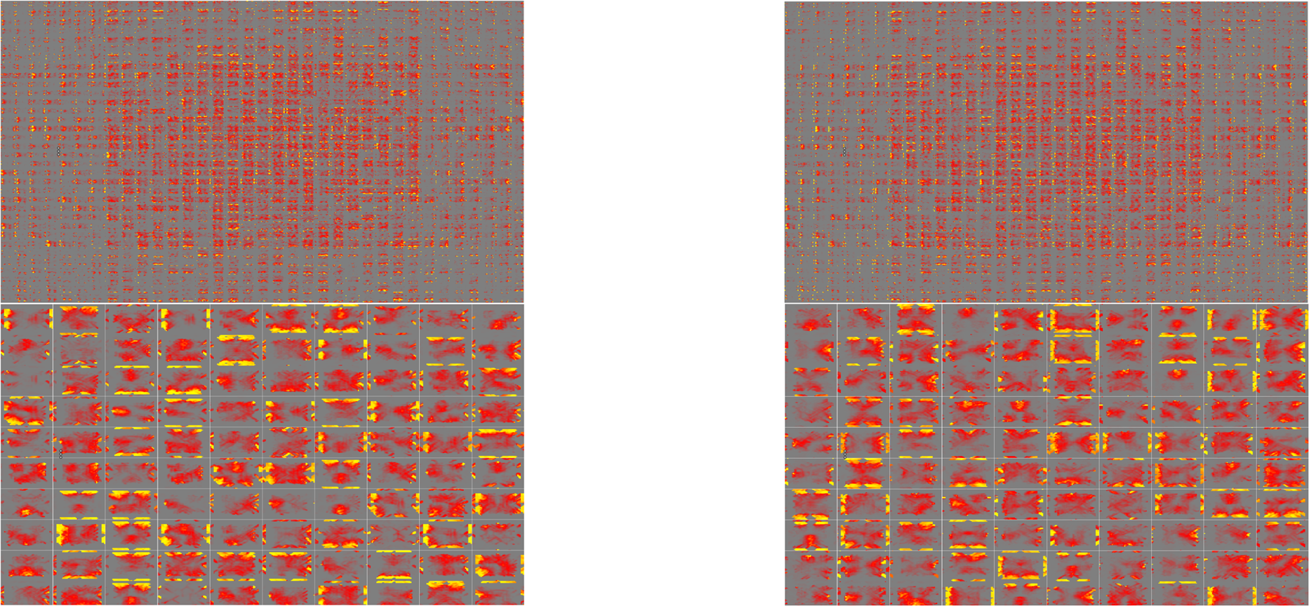
Different objects(Face)
Original Network
Network with V1IT connection
Notes:
Similarly, let's take a look at the receptive field of the V4 and IT layers. As you can see from the figure, layer V4 seems to be the most sensitive to the mouth of each expression. The receptive field of the improved network also has more units that are more active and have more distinct features.

Slide 15
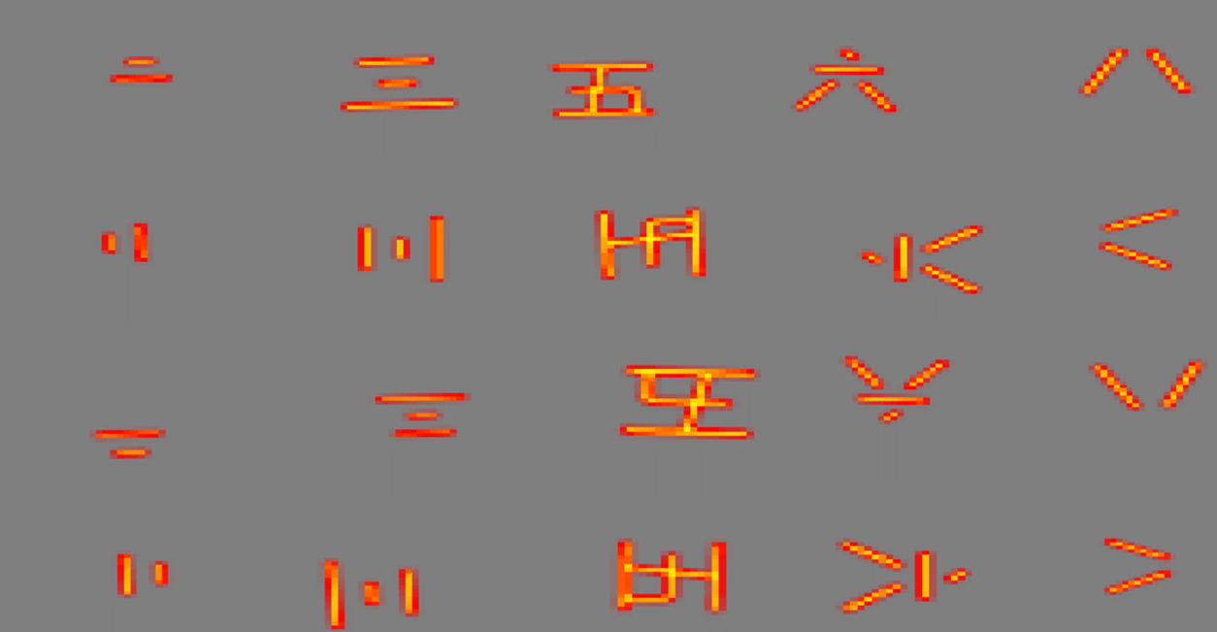
Different objects(Chinese Number)
•Vertical,horizontal and oblique
•Different length
•4 directions
Notes:
The third set of figures are Chinese numbers. This set of figures consists of five Chinese numbers, 2,3,5,6 and 8. Each of these numbers has four different directions. This makes up a total of 20 different shapes. These numbers are characterized by horizontal, vertical and diagonal lines.

Slide 16
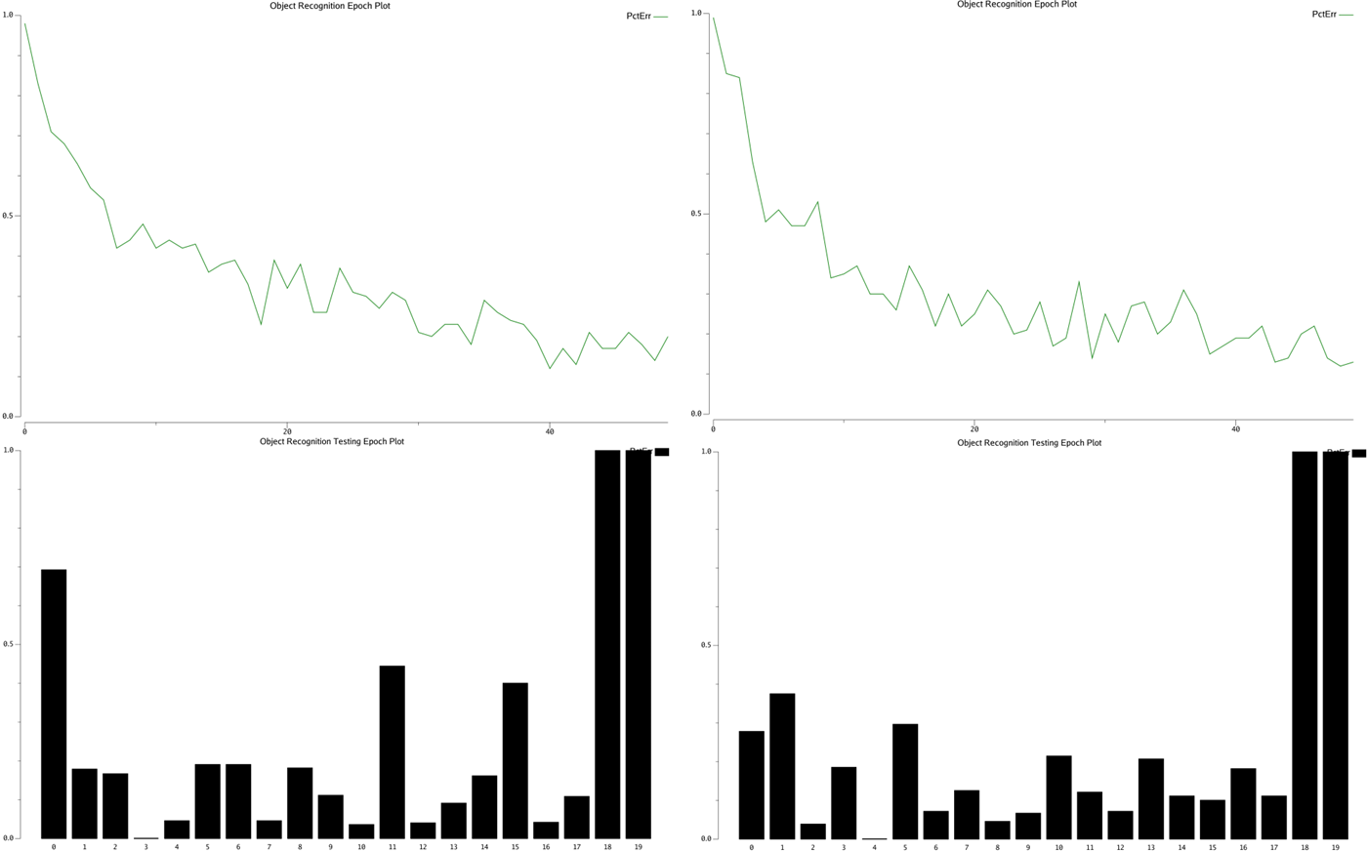
Different objects(Chinese Number)
Original Network
Network with V1IT connection
Fewer errors overall
Notes:
Through training and testing, we get the training graphs and test results of different networks for this group of graphs. We can also find that the improved network can be trained to achieve lower errors and identify objects more accurately, and the generalization ability of the improved network does not increase. It can be seen from the results that this group of graphics is the least effective training among the three groups of graphics, which indicates that this group of graphics is the most complex for the network.

Slide 17
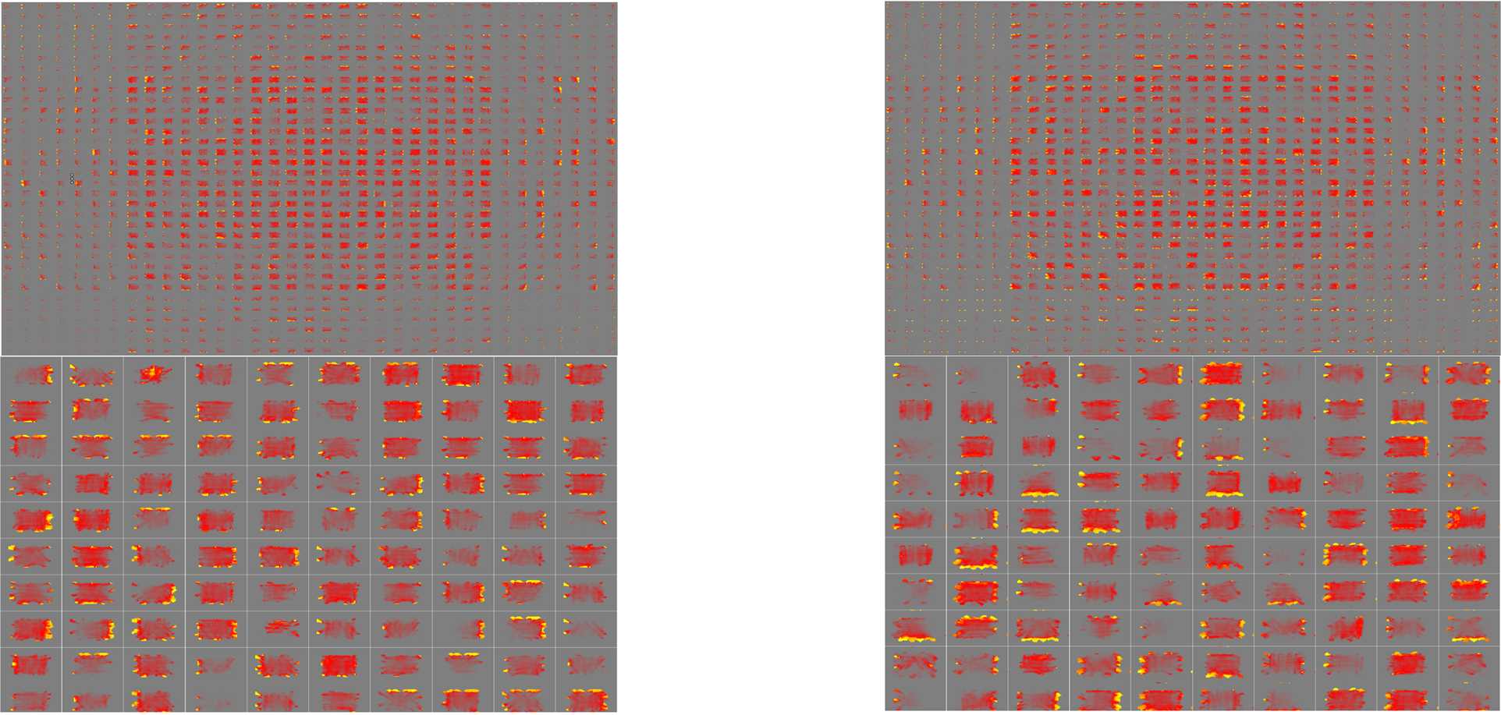
Different objects(Chinese Number)
Original Network
Network with V1IT connection
Notes:
Similarly, let's take a look at the receptive field of the V4 and IT layers. As you can see from the figure, layer V4 seems to be most sensitive to the two slash lines per number 6 and 8. The receptive field of the improved network also has more units that are more active and have more distinct features. In conclusion, through testing these three different sets, we can find that adding bidirectional connections between V1 and IT will increase the ability of network.

Slide 18
Different connection sizes
Notes:
Hello everyone Let me introduce the effect of changing the size of the model connection weights.

Slide 19
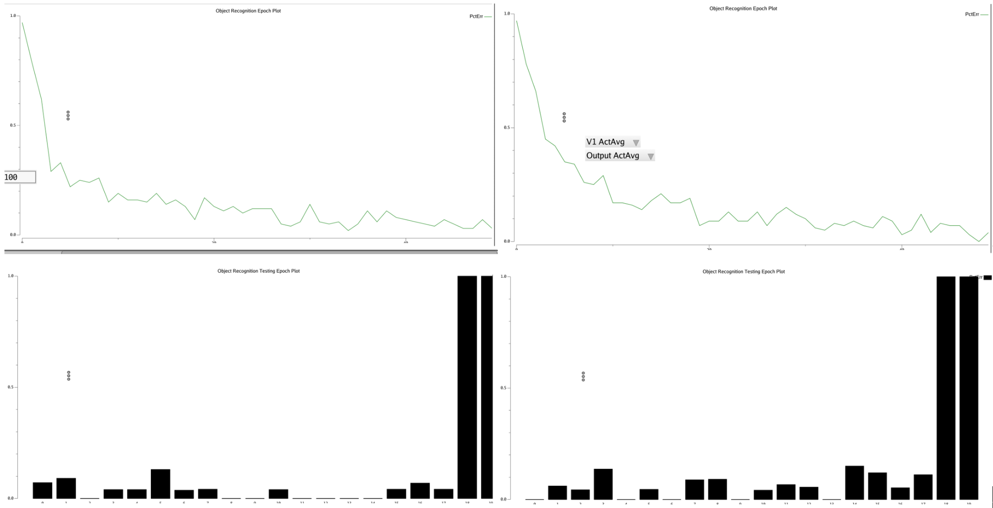
Different connection sizes
A too large connection size can lead to a number of problems (e.g. may increase the computational burden and may lead to overgeneralization of the network)
Try to decrease the original connection size
The error ratio did not decrease but increased, indicating that we can try to increase the connection size to reduce the error rate
Original Network
V1-V4 (4 x 3, Row x Column)

Slide 20
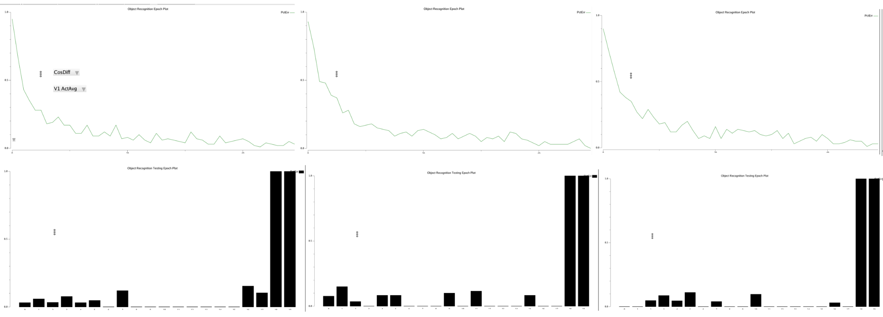
Different connection sizes
V1-V4 (6 x 5, Row x Column)
V1-V4 (8 x 6, Row x Column)
V1-V4 (10 x 8, Row x Column)
Notes:
So I tried to increase the size of the connection, and this is the result of the three resulting figures for 6 by 5, 8 by 6 and 10 by 8 connection sizes respectively. It is clear that 10 by 8 size results are optimal. This shows that increasing the connection size from V1 to V4 has improved the model performance.

Slide 21
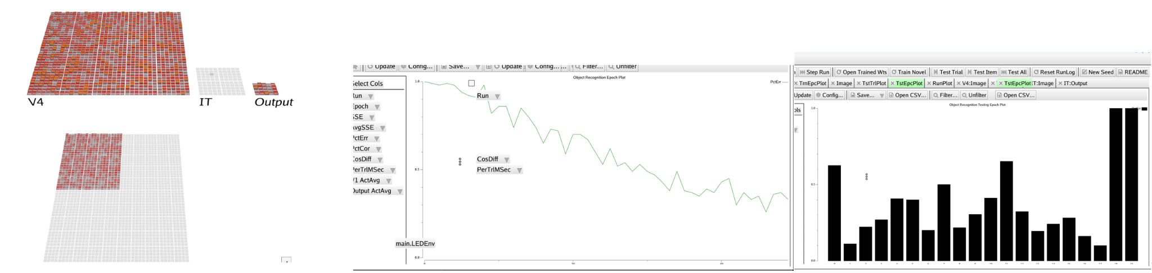
Different connection sizes
Try to partially connect V1 to IT
It can be observed that the error rate has increased rather than decreased
Connecting parts of V1 to their counterparts in IT can result in partial loss or incomplete transmission of information to higher-level neurons
Try to expand the connection size of V1 to IT
Notes:
After doing this I try to discuss the effect of changing V1 to IT weight size on the model.

Slide 22
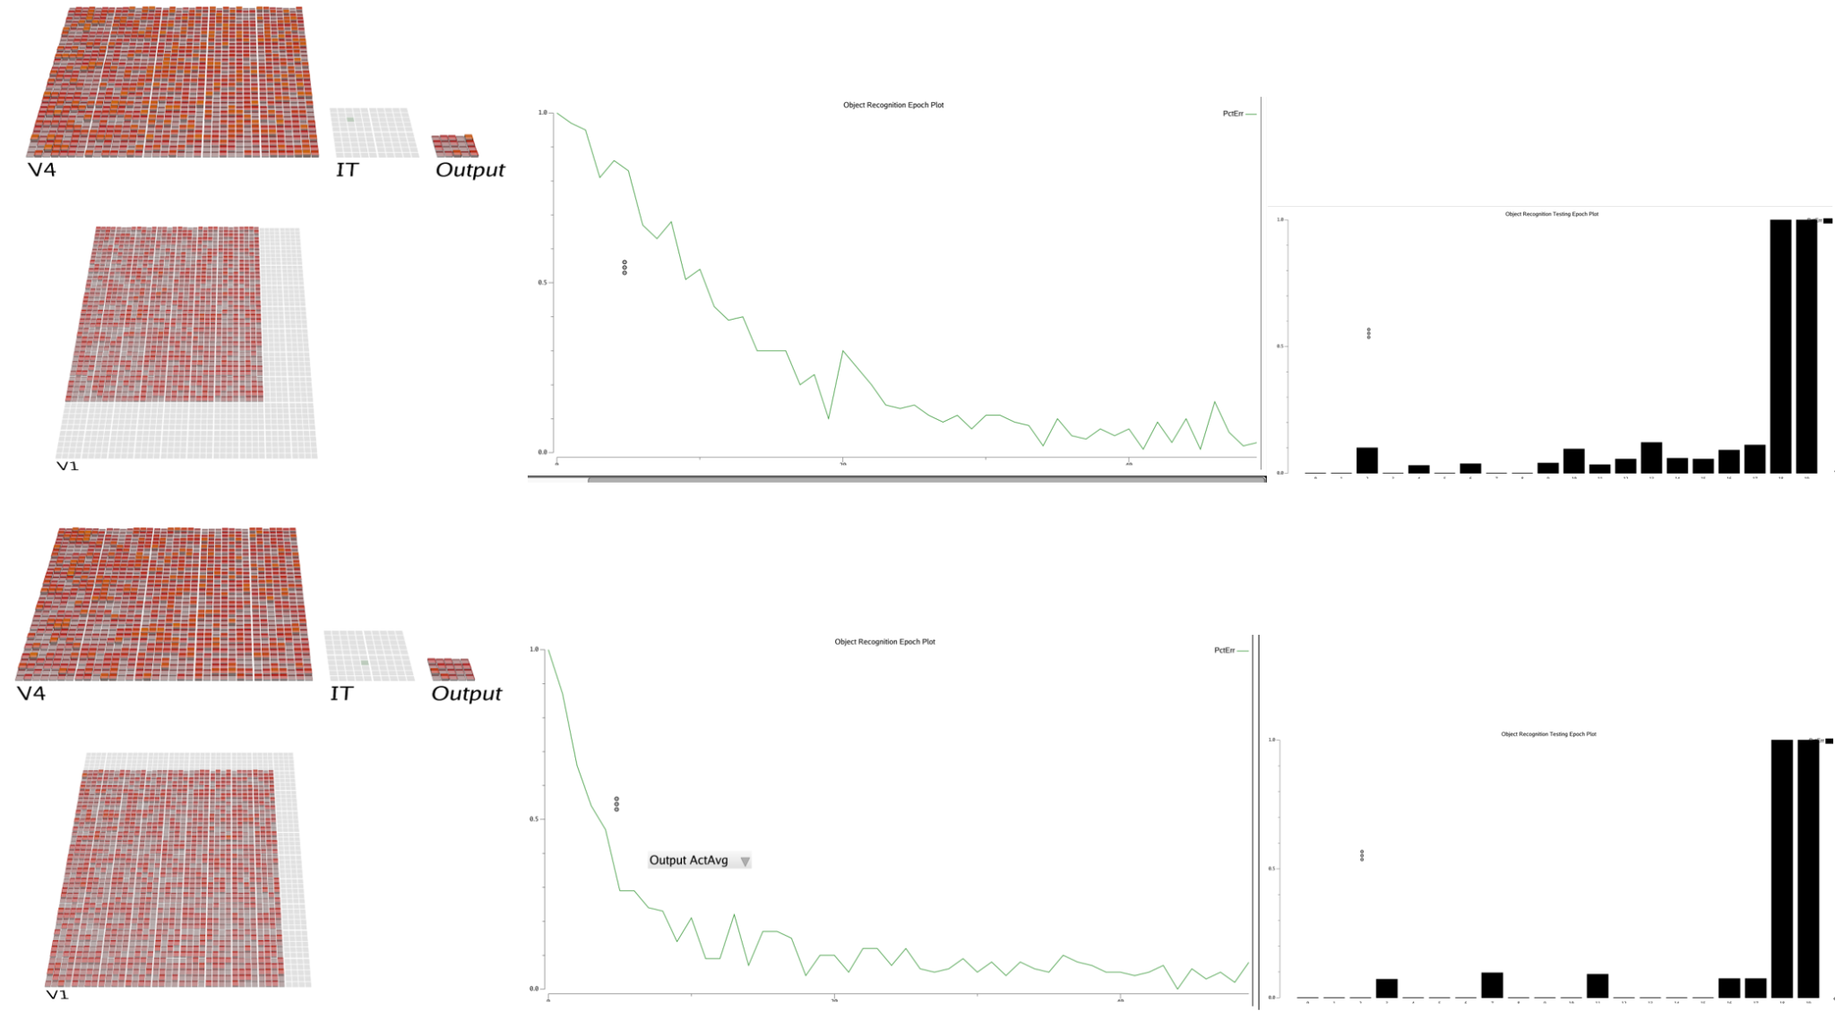
Different connection sizes
Notes:
We can obviously find that when the connection size of v1 is 9*9, the effect is significantly better than that of 8*8, 9*9 size which produces a very good effect, and the error rate of nearly 0 is achieved in all 13 patterns

Slide 23
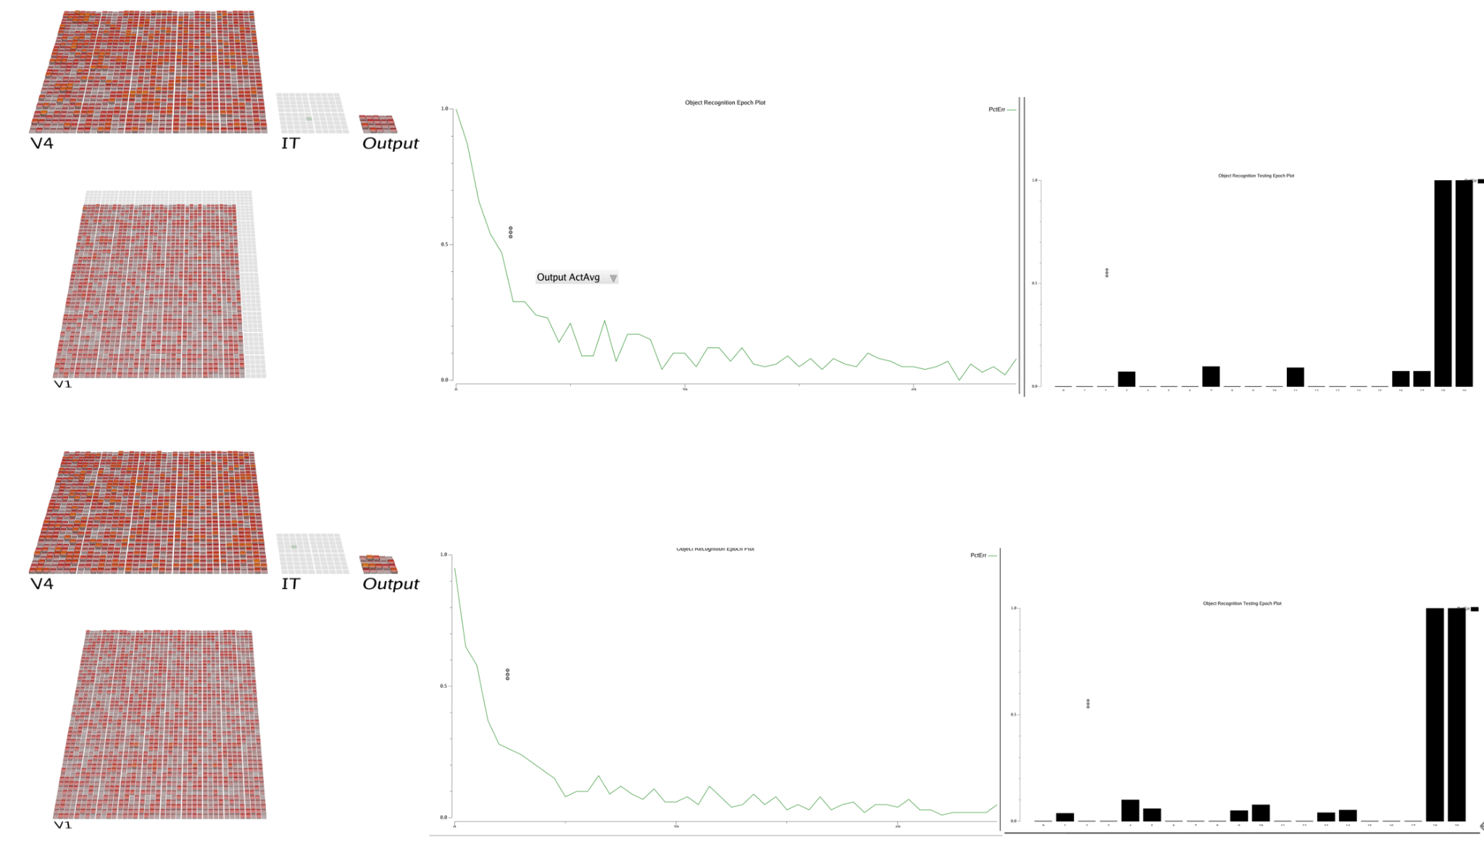
Different connection sizes
9 x 9
Full connection
Notes:
Some may ask, how can you prove that 9*9 is the best connection parameter if you haven't tried a full connection? This is the result of 9*9 connection and full connection comparison, you can find that the 9*9 connection effect is better than the full connection. This is because full connection potentially leading to increased computational complexity and overfitting.

Slide 24
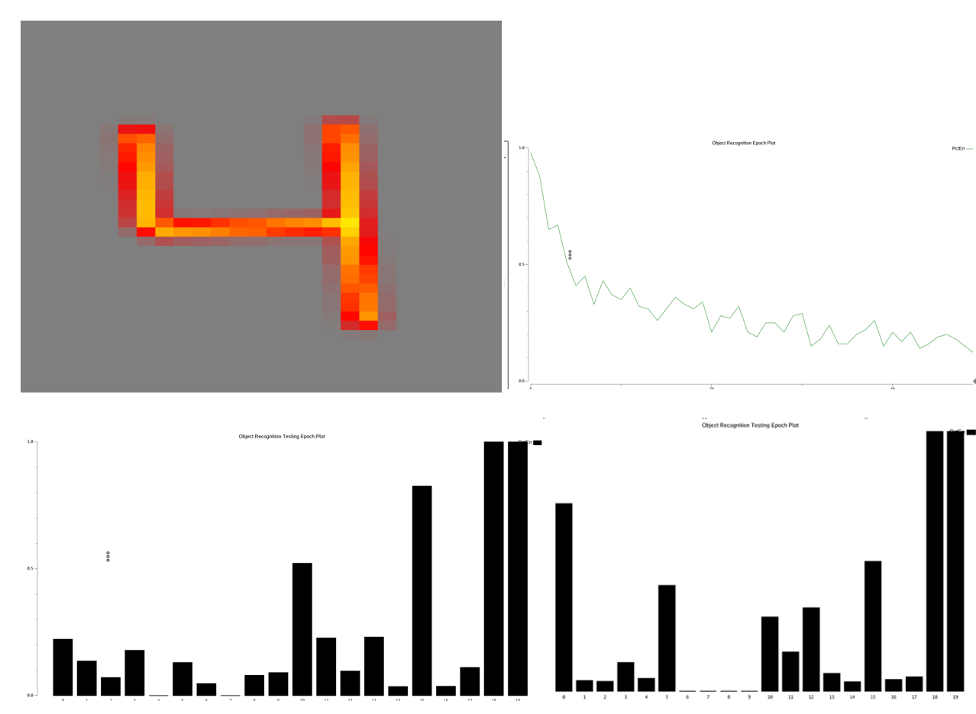
Different connection sizes (Number)
Robust Full Connection
The robust model with the adjusted V1 to V4 weight size and V1 to IT weight size has better results on number patterns than the previously unadjusted size V1 to IT fully connected model
Notes:
Then I tried to test the robust model on different datasets. This is the resulting figure of the robust model implemented on the number data set

Slide 25
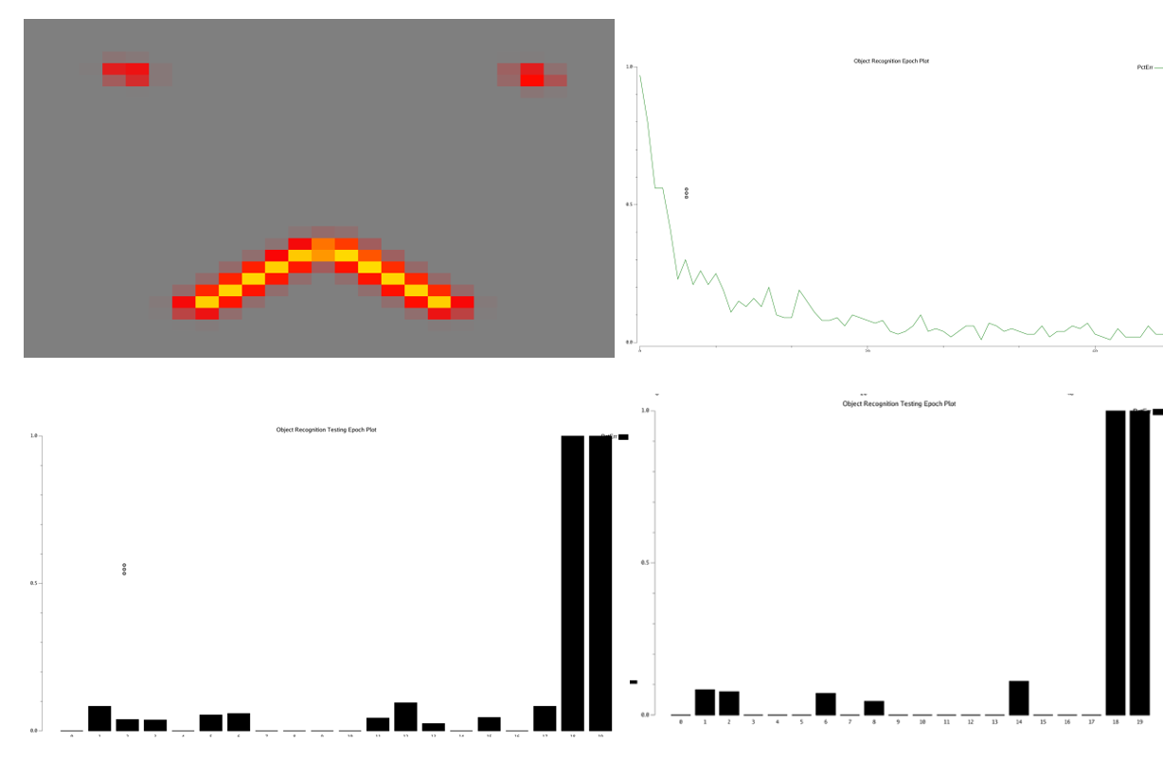
Different connection sizes (Face)
Robust Full Connection
The performances are almost the same for the face dataset
Notes:
And this is the resulting figure of the robust model implemented on the face data set

Slide 26
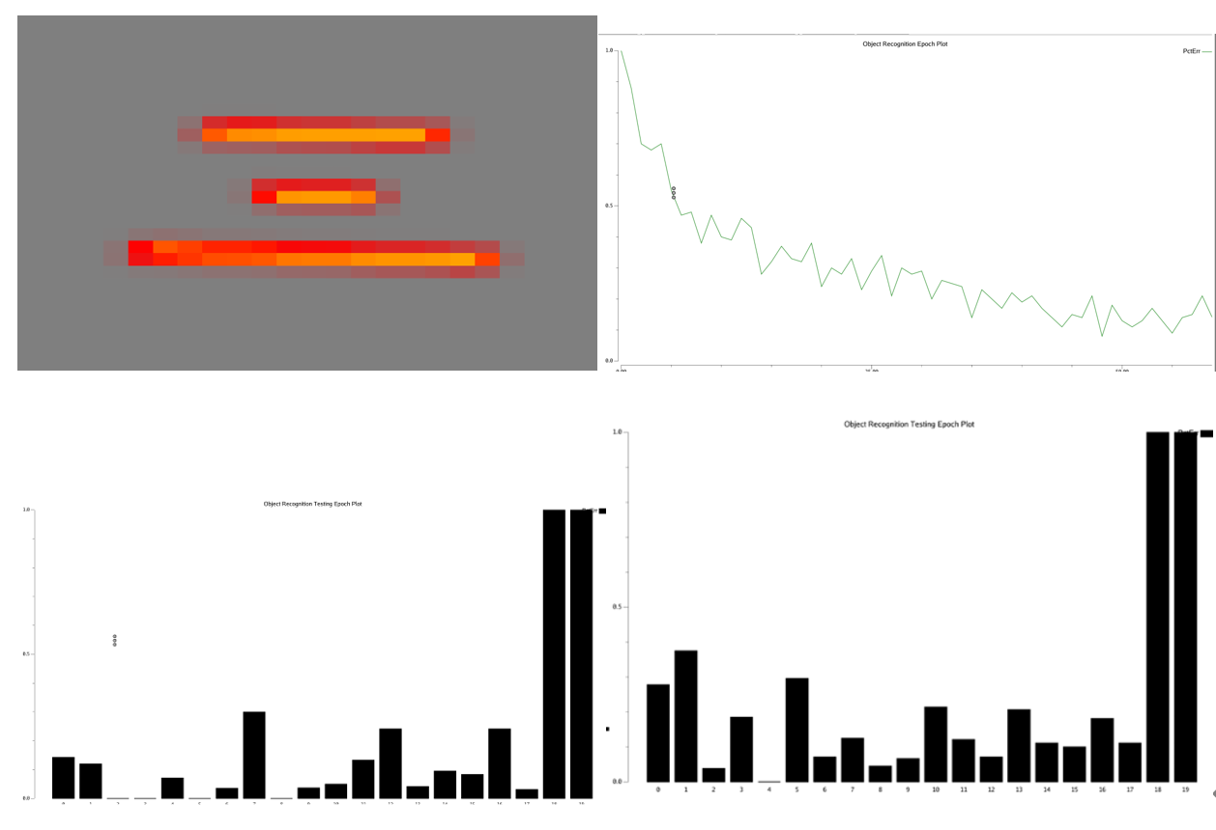
Different connection sizes (Chinese Number)
Robust Full Connection
The performance of Robust model on the Chinese number dataset is exceedingly better than that of fully connected model
The test results on the three data sets prove the importance of changing the weight size to improve the model effect

Slide 27
Thank you
Project github repo link: https://github.com/cho-wang001/CLPS1492_Final_Project

